Slide 1
C-STORE OFFICE
ADVANCED ACCOUNTING - THE DATA CONVERTER TOOL
www.cstoreoffice.com

Slide 2
Agenda
Review of Accounting Setup in CSO
What are Transaction Assignments and why are they needed
What are Data Types
What is the Data Converter Tool
Basics of running the Data Converter Tool
Why is it necessary to update using the Data Converter Tool
www.cstoreoffice.com

Slide 3
Review of Accounting Setup in CSO
Chart of Accounts is Required
COA Standard is provided
COA Custom (provided by customer ) can be used
www.cstoreoffice.com

Slide 4
What are Transaction Assignments and why they are necessary
Transaction Assignments are the data mapping in CSO
Data is mapped based on the type and given a specific Debit and Credit General Ledger Account
The Transaction Assignments are the basis of how things get into your General Ledger
www.cstoreoffice.com

Slide 5
What are Transaction Assignments and why they are necessary
www.cstoreoffice.com

Slide 6
What are Data Types ?
Data Types are the transactions grouped together , based on where they originate in the system. Example: Cash Register / Cash Data Type originates from the Cash Register and is the Cash Method of Payment. Example: Gasoline Purchases Data Type originates from the Gasoline Invoices when Gasoline is purchased.
www.cstoreoffice.com

Slide 7
What is the Data Converter Tool ?
The Data Converter Tool is a way to refresh the data as it moves over into the Accounting Module of CSO.
The Data Converter Tool is a custom interface that identifies the different types of Data and allows the data to move over to accounting, based on the Data Type.
www.cstoreoffice.com

Slide 8
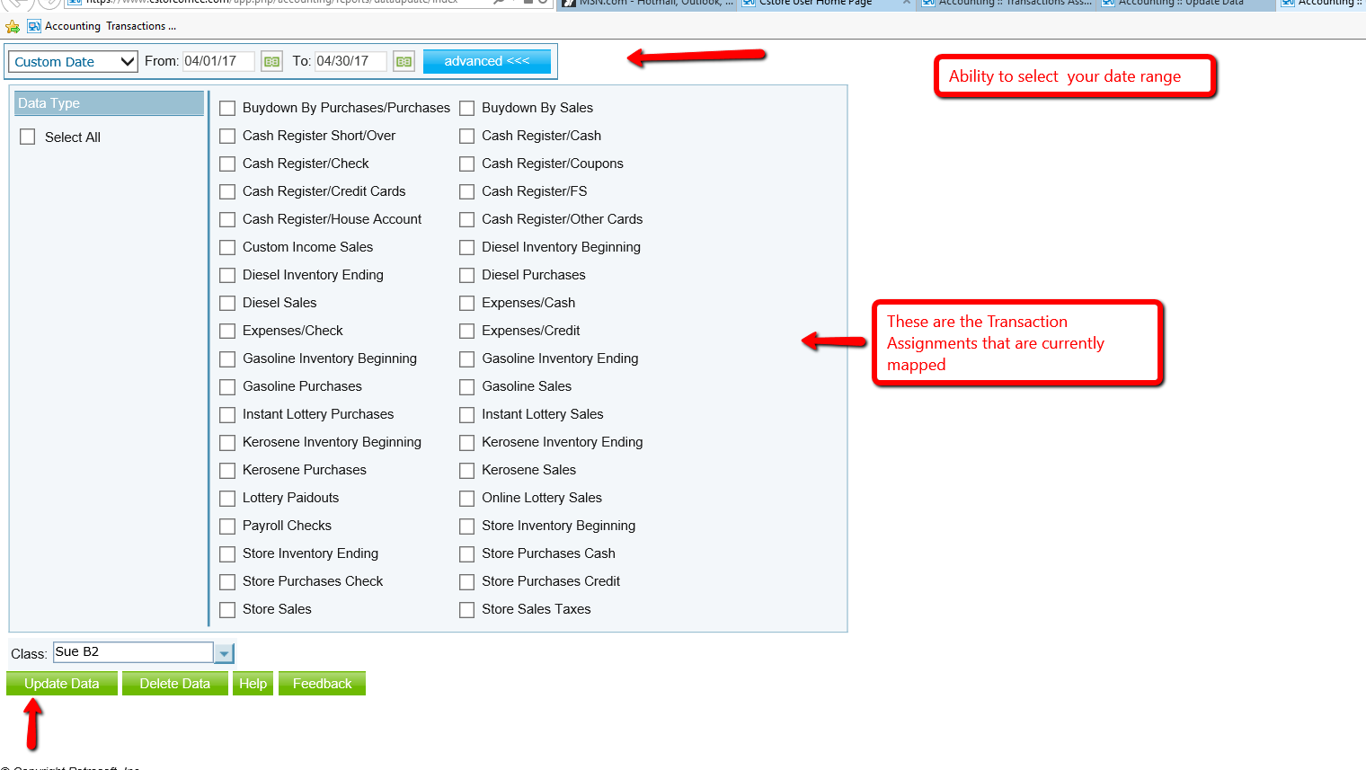
www.cstoreoffice.com

Slide 9
Basics of running the Data Converter Tool
Can Select All Data Types or just the specific one(s) you are trying to update.
Should never select the beginning and ending inventory Data Types for update
Must run for a specific class, so will need to update for all classes if necessary
Can select a specific date or range of dates. Obviously the longer the range of dates and more types you select…..the longer the processing time.
NEVER delete data, ONLY update data
www.cstoreoffice.com

Slide 10
Why is it necessary to update using the Data Converter Tool ?
The conversion of data over to Accounting should be real time. However it is sometimes necessary to run the Data Converter Tool to ensure all data is transferred to Accounting.
If you see that your CSO clearing account is out of balance
If you made multiple changes to your Cash Reconciliation screen
If you see other “missing data” from accounting
www.cstoreoffice.com

Slide 11
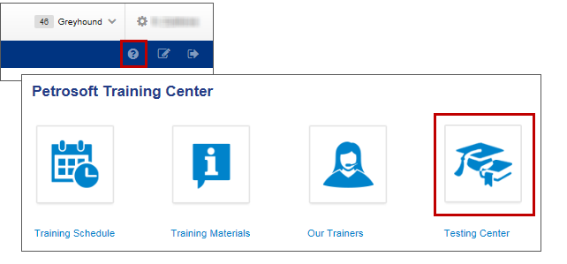
Training Center
For additional testing on what you have learned, please refer to our new “Testing Center”.
To access this new feature, click the help icon, and then select Testing Center.
www.cstoreoffice.com

Slide 12
THANK YOU FOR YOUR TIME!
Get in Touch
Petrosoft LLC
290 Bilmar Drive
Pittsburgh, PA 15205
1.412.306.0640
www.cstoreoffice.com

